Slide 1

Heart Disease Prediction Using Machine Learning
By
Ishrat Jahan
19121909042
Maria Rahman Jui
1922236642

Slide 2
Corrections
Mention the number of Data points
Remove Heart Disease from Categorical Features
Implement SMOTE
Correction of Confusion Matrix to match the number of test data points
Implement SVM Model
1

Slide 3
Objective
Accurately Predict Heart Disease
Based on Health Parameters
Determine the best performing model
2

Slide 4
Dataset Description
Titled “Heart Disease Prediction”
2020 dataset
Annual CDC survey for people of most races in US
Originally 319795 rows × 18 columns
Reduced to 1999 data points and 18 attribute to use in this project
No duplicate/missing/null values
Two target variables (No=Absence of Heart Disease, Yes=Presence of Heart Disease)
Categorical Features: Smoking, Alcohol Drinking, Stroke, Diff Walking, Sex, Race, Diabetic, Physical Activity, GenHealth, Asthma, Kidney Disease, Skin Cancer
Continuous Features: BMI, Physical Health, Mental Health, Age Category, Sleep Time
Source: Kaggle
3

Slide 5
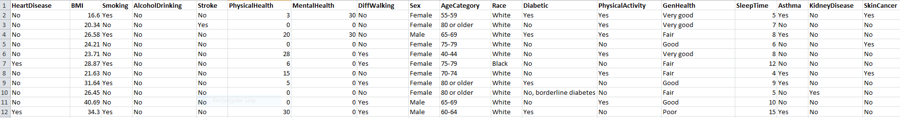
Dataset Description
4

Slide 6
Dataset Description
Attributes
BMI: Body Mass Index
Smoking: Smoked at least 100 cigarettes in entire life or not?
Alcohol Drinking: Consumes alcohol or not
Physical Health: For how many days was physical health not good?
Mental Health: For how many days was mental health not good?
Difficulty walking: Any difficulty faced during walking ?
Gender: Female or Male
Age: Age of the person
Physical Activity: Any sort of exercise or activity?
Race: Imputed race/ethnicity value
Diabetic: Has or not
General Health: How is it in general
Sleep time: How many hours of sleep the user get in a day?
Asthma: Have or not?
Kidney Disease: Have or not
Skin Cancer: Have or not
Stroke: Any prior history
Target: Have heart disease or not
5

Slide 7
Data Cleaning and Preprocessing
SMOTE Algorithm
Dataset Balancing
Continuous Features
Scale them between 0 and 1
Categorical Features
Features with 2 unique values to binary(either 0 or1)
One-hot encode the ones that have more than 2 unique values
Testing and Validation
80% for training
20% for testing
6

Slide 8
System Diagram
Data Collection
Naive Bayes
Random Forest
KNN
Logistic Regression
Decision Tree
Data Preprocessing
Data Splitting
Apply Machine Learning Algorithm
Predict the probability of having Heart Disease

Slide 9
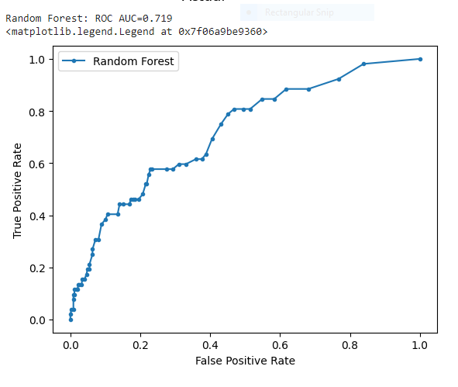
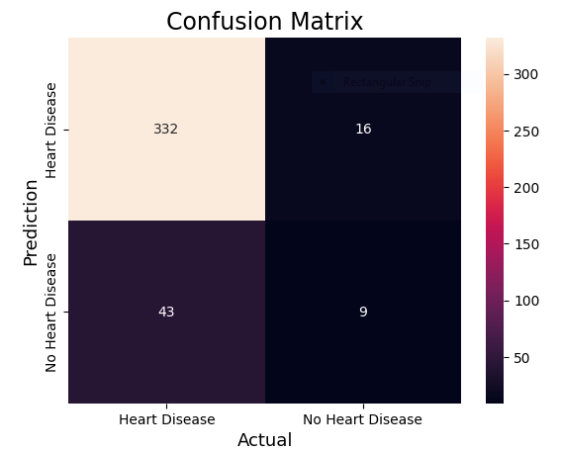
Analysis of algorithm
Random Forest
Accuracy: 85.25%

Slide 10
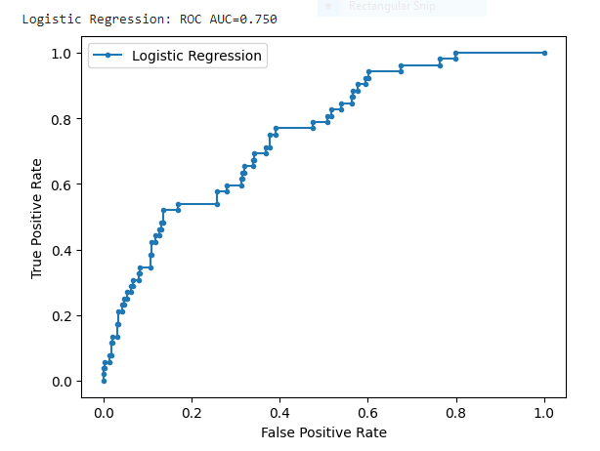
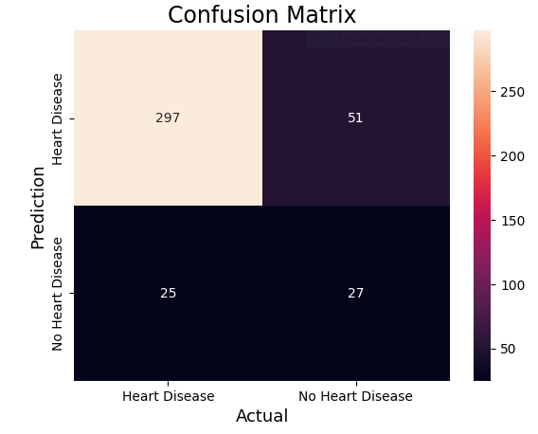
Logistic Regression
Accuracy: 81.0 %
9

Slide 11
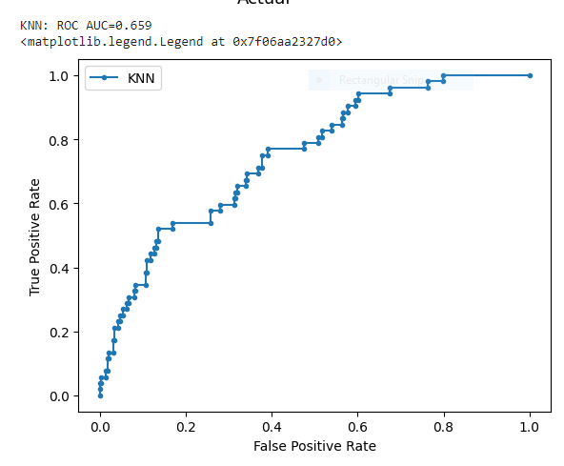
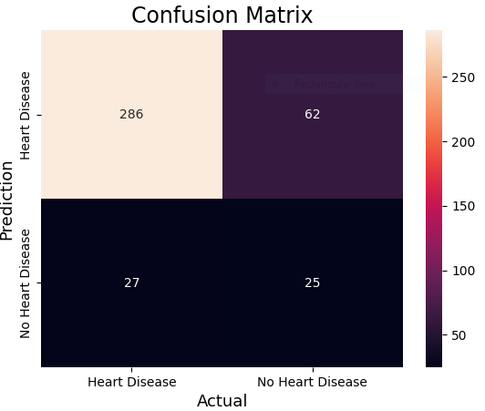
KNN
Accuracy: 77.75 %

Slide 12
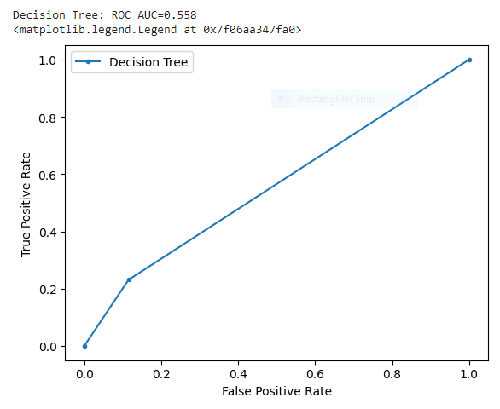
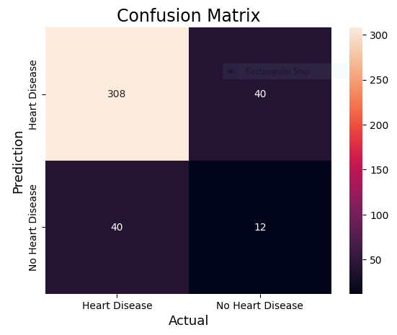
Decision Tree
Accuracy: 80.0%

Slide 13
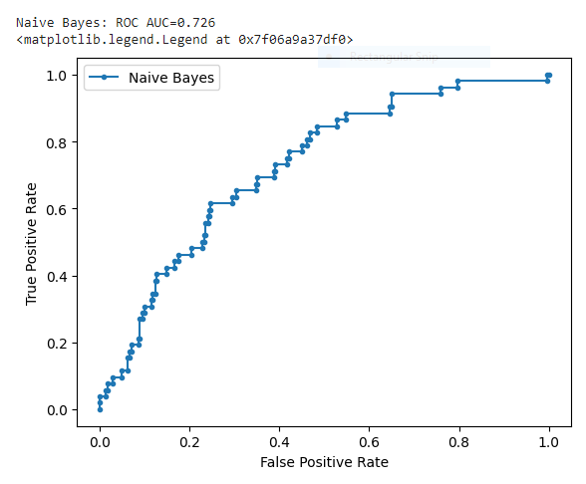
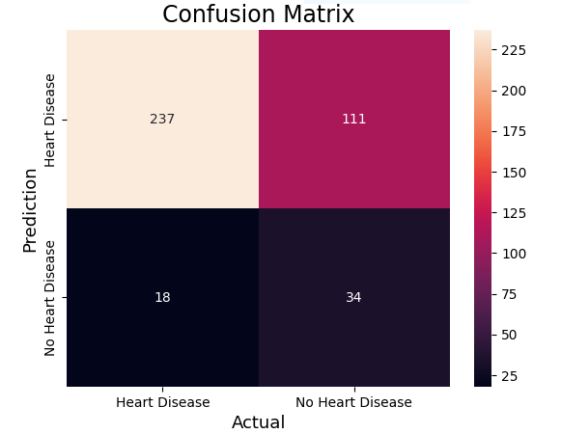
Naive Bayes
Accuracy: 67.75%

Slide 14
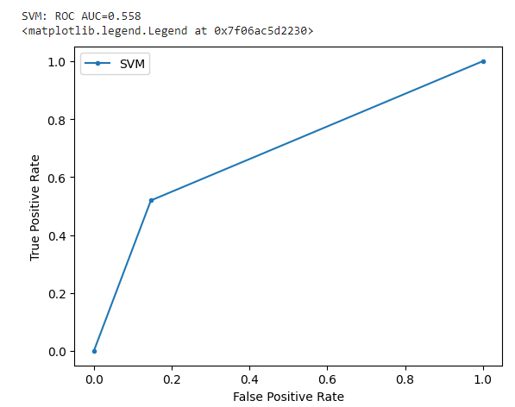
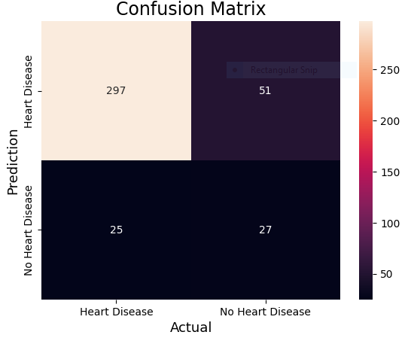
SVM
Accuracy: 81.0%

Slide 15
Comparisons of Performance
Classification Model | Accuracy | Precision | Recall | F1 Score
Random Forest Classifier | 0.8525 | 0.820 | 0.850 | 0 .830
KNN | 0.7775 | 0.830 | 0.780 | 0.800
Decision Tree | 0.800 | 0.800 | 0.800 | 0.800
Logistic Regression | 0.810 | 0.850 | 0.810 | 0.830
Naïve Bayes | 0.6775 | 0.840 | 0.680 | 0.730
SVM | 0.810 | 0.850 | 0.810 | 0.830

Slide 16
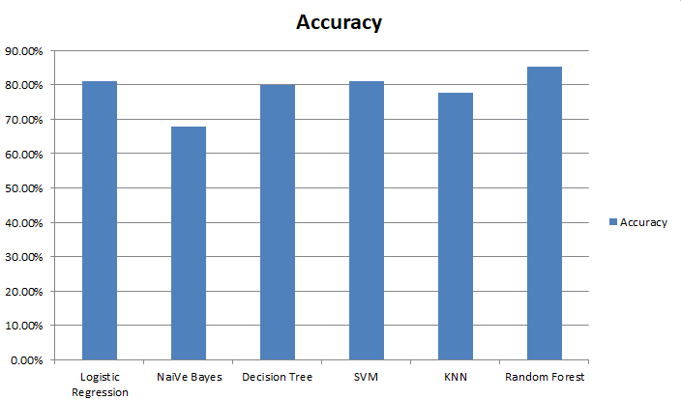
Comparison of Performance
15

Slide 17
Comparison of Performance
Random Forest Classifier performs the best
Highest accuracy for the dataset
Highest F1-score
Logistic Regression accuracy closest to the highest accuracy with same F1-score as Random Forest
16

Slide 18
Thank You
Any Queries?

